Slide 1
Grampa, what’s a deleted tweet? By: Mohammed Nauman Siddique
&
Delete Forensics
By: Ed Summers
Presented by: Harveen Kaur
CS 795: Web Archiving Forensics
Department of Computer Science
Old Dominion University

Slide 2
Breitbart News
Far-right American news network
Content has been labelled misogynistic, xenophobic, and racist
Has been known to post conspiracy theories
Spread disinformation
“The Huffington post of the right”-Steve Bannon
https://en.wikipedia.org/wiki/Breitbart_News
Harveen Kaur CS 795: Web Archiving Forensics (Fall 2020)

Slide 3
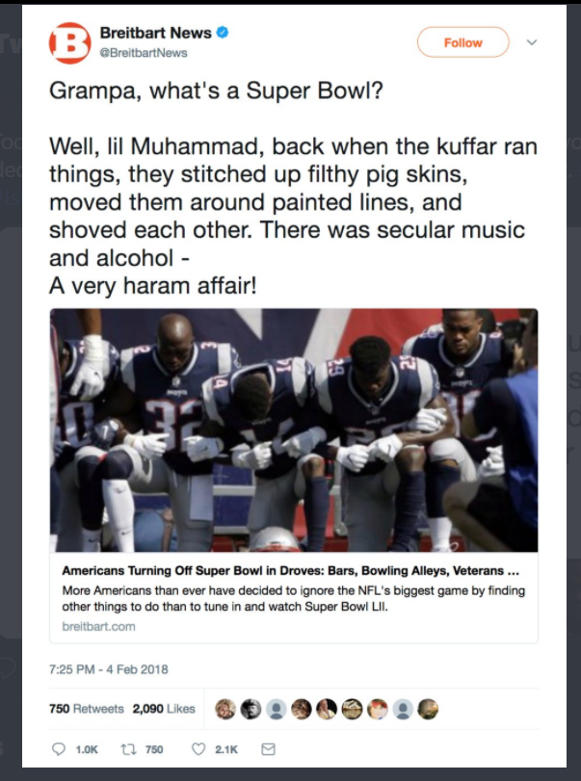
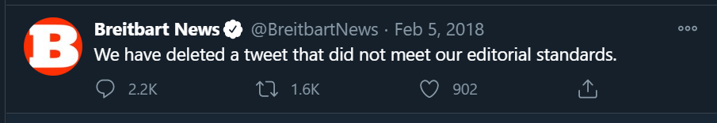
Provocative tweet by Breitbart News
“Suggest that Muslims will bring an end to Super Bowl”
Screenshot of the tweet taken by @CasMudde
Breitbart News deleted the tweet after 12 hours
https://twitter.com/CasMudde/status/960546130684768256/photo/1 https://ws-dl.blogspot.com/2018/04/2018-04-23-grampa-whats-deleted-tweet.html
https://thehill.com/homenews/media/372362-breitbart-deletes-super-bowl-muslim-tweet
Harveen Kaur CS 795: Web Archiving Forensics (Fall 2020)

Slide 4
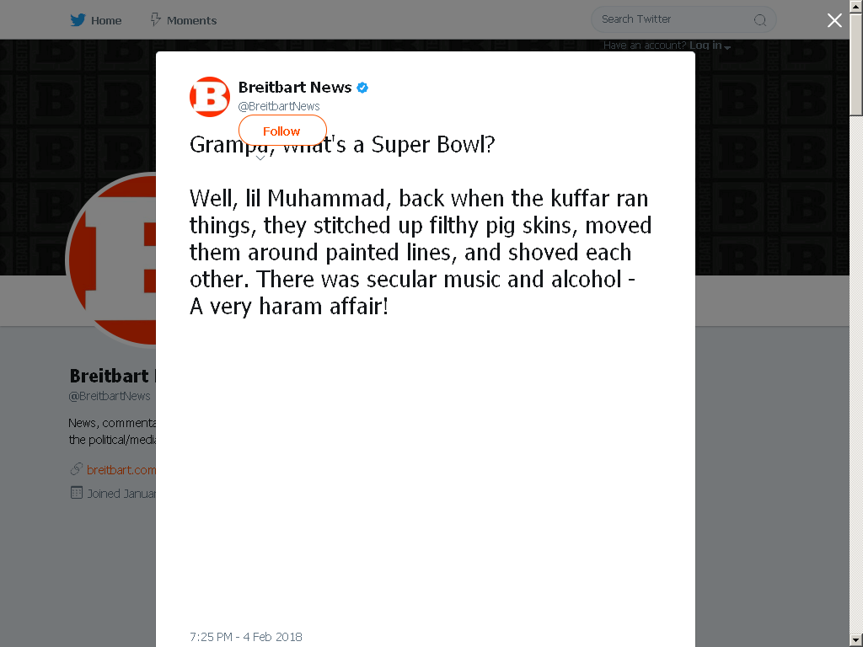
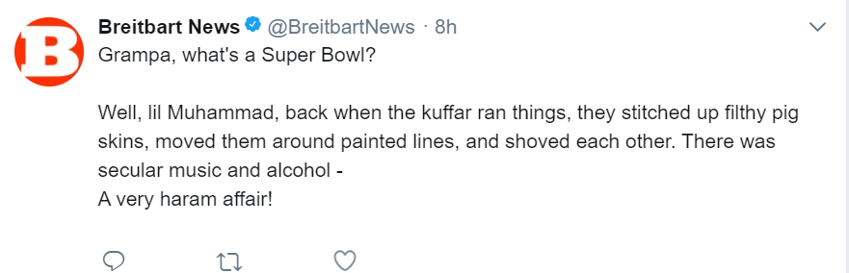
Mementos of the tweet present in the archives
Memento in archive.is
Wayback Machine :https://web.archive.org/web/20180205102727if_/https://twitter.com/BreitbartNews
archive.is
https://archive.is/eAa6h
Harveen Kaur CS 795: Web Archiving Forensics (Fall 2020)

Slide 5
Importance of Web Archives
Helps preserve the web, can recover deleted tweets
Saves the entire web page
Used as evidence in court cases
For less popular accounts it may be difficult to find mementos
https://items.ssrc.org/parameters/on-the-importance-of-web-archiving/
https://ws-dl.blogspot.com/2018/04/2018-04-23-grampa-whats-deleted-tweet.html
Harveen Kaur CS 795: Web Archiving Forensics (Fall 2020)

Slide 6
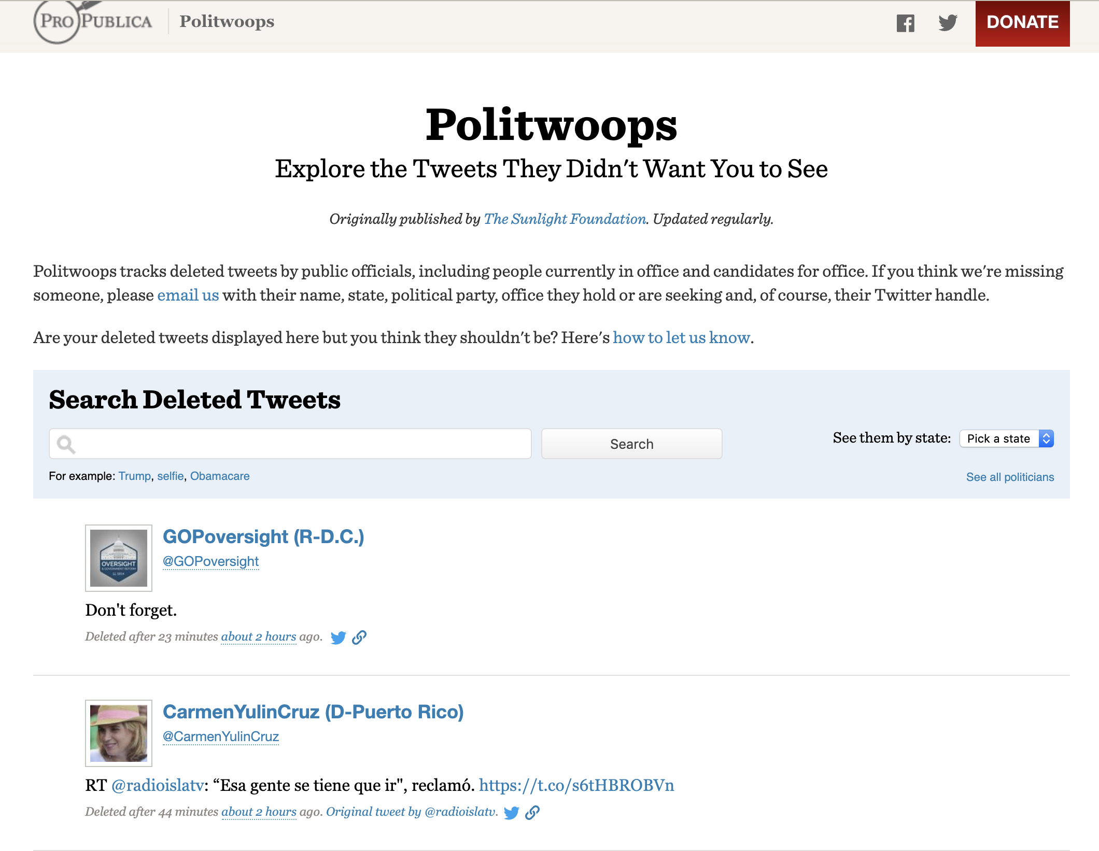
Politwoops tracks deleted tweets
Keeps track of deleted tweets (USA and some EU Nations) from current public officials as well as candidates for office.
Cannot rely on such web services as these services can be banned.
Sometimes it does not track officials
Politwoops and Diplotwoops were banned in 2015 by Twitter for violating its developer agreement
https://projects.propublica.org/politwoops/
https://web.archive.org/web/20150826232106/https://www.businessinsider.com/twitter-bans-politwoops-diplotwoops-global-api-access-revoked-open-state-foundation-2015-8
https://www.crunchbase.com/organization/diplotwoops
Harveen Kaur CS 795: Web Archiving Forensics (Fall 2020)

Slide 7
The process of finding deleted tweets by Breitbart News
3200 tweets were fetched using Twitter API.
Span of the 3200 tweets was from 2017-10-22 to 2018-02-18
Memgator was used to get the TimeMap for Breitbart’s Twitter page
Mementos from the TimeMap were collected that were from 2017-10-22 to 2018-02-28
https://ws-dl.blogspot.com/2018/04/2018-04-23-grampa-whats-deleted-tweet.html
Harveen Kaur CS 795: Web Archiving Forensics (Fall 2020)

Slide 8
Comparison of live and archived tweets of Breitbart News
On comparison, of the live tweets fetched using the Twitter API and the archived tweets from Breitbart News it was found that 22 tweets were deleted.
Timespan of deleted tweets: 2017-10-22 to 2018-02-18 (4 months)
Most prominent deleted tweet: “Grampa, what’s a Super Bowl?”
https://ws-dl.blogspot.com/2018/04/2018-04-23-grampa-whats-deleted-tweet.html
Harveen Kaur CS 795: Web Archiving Forensics (Fall 2020)

Slide 9
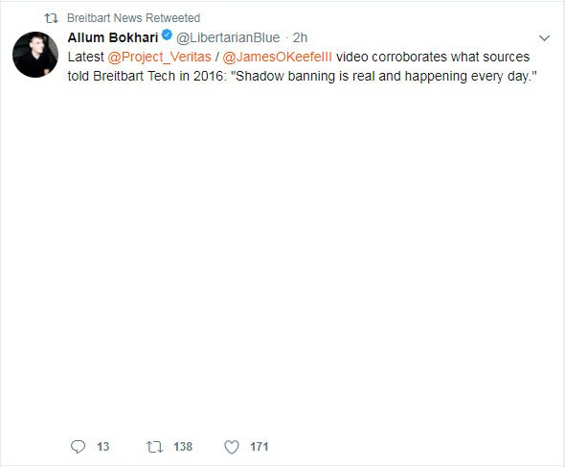
Breitbart News removed retweets
Tweeted Breitbart’s article on shadowbanning
Allum Bokhari :
Senior Technology Correspondent at Breitbart News
Negative space because the card layout for https://www.breitbart.com/tech/2016/02/16/exclusive-twitter-shadowbanning-is-real-say-inside-sources/ was not saved but space for it was preserved
Original tweet still available on Twitter
Re-tweet by Breitbart News unavailable on the live web
https://www.linkedin.com/in/allum-bokhari-7b5a6050/?originalSubdomain=uk
https://web.archive.org/web/20180321034201/https:/twitter.com/LibertarianBlue/status/951465189161029632
https://ws-dl.blogspot.com/2018/04/2018-04-23-grampa-whats-deleted-tweet.html
https://twitter.com/LibertarianBlue/status/951465189161029632https://www.breitbart.com/tech/2016/02/16/exclusive-twitter-shadowbanning-is-real-say-inside-sources/
Harveen Kaur CS 795: Web Archiving Forensics (Fall 2020)

Slide 10
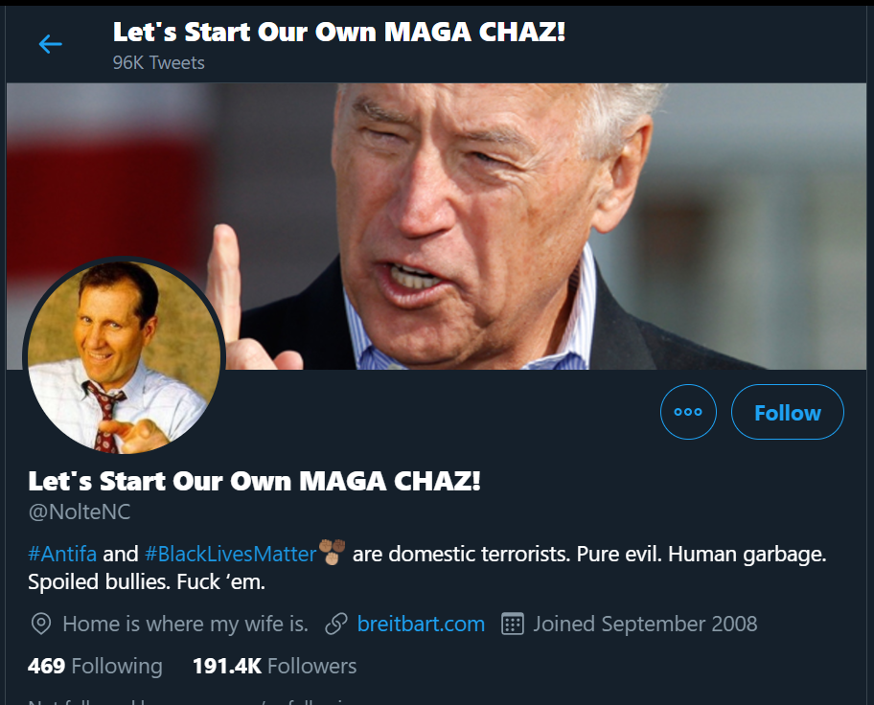
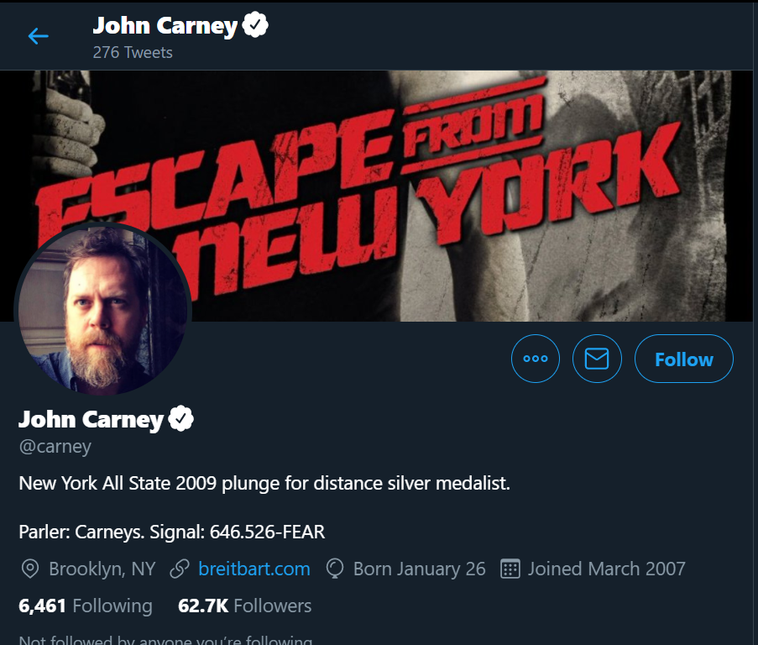
Accounts that Breitbart News retweeted
Out of 22 deleted tweets by Breitbart News, 18 were retweets from John Nolte (Twitter- @NolteNC) and John Carney (Twitter- @carney) both affiliated with Breitbart News
Breitbart: Editor
https://twitter.com/NolteNC
Breitbart: Editor, Economics & Finance
https://twitter.com/carney
https://ws-dl.blogspot.com/2018/04/2018-04-23-grampa-whats-deleted-tweet.html
https://www.linkedin.com/in/john-carney-77a9131/
https://muckrack.com/john-nolte
Harveen Kaur CS 795: Web Archiving Forensics (Fall 2020)

Slide 11
Tweets deleted by John Carney
Live tweets were fetched using the Twitter API
Tweets were fetched for a week
Tweets were automatically deleted every Tuesday and Saturday
Such preciseness in the deletion of tweets suggest use of tweet deletion services
https://ws-dl.blogspot.com/2018/04/2018-04-23-grampa-whats-deleted-tweet.html
Harveen Kaur CS 795: Web Archiving Forensics (Fall 2020)

Slide 12
Tweets deleted by John Nolte
Live tweets were fetched using the Twitter API
TimeMap was also fetched using the Memgator within the same time range
169 live tweets were found
3569 tweets were deleted from 2017-11-03 to 2018-02-17
Seems unlikely that these tweets were deleted manually
Live tweets were collected for a week
Comparing these live tweets to the ones collected before shows that tweets were deleted if they were available for more than 7 days
Tweets were deleted every Wednesday and Saturday
https://ws-dl.blogspot.com/2018/04/2018-04-23-grampa-whats-deleted-tweet.html
Harveen Kaur CS 795: Web Archiving Forensics (Fall 2020)

Slide 13
Twitter delete services
Tweeter Deleter
Search by: keyword, tweet type (tweets, retweets and replies), tweet date,
media type (pictures, Instagram, YouTube), auto delete old tweets
TweetEraser
Search by: keyword, filter, gives a list of tweets, can delete multiple tweets at the same time
https://www.tweeteraser.com/
https://tweetdeleter.com/
Harveen Kaur CS 795: Web Archiving Forensics (Fall 2020)

Slide 14
Reasons why tweets are deleted
Unavailability of a tweet doesn’t necessarily mean the tweet was deleted, if a user decides to make their account private, tweets by the account will only be available to approved followers
Deletion of an account results in deletion of the tweets
Account suspension because the account was source of spam or abuse
If there is a retweet and the original tweet is deleted, the retweet will also be removed
Twitter users flag other tweets as abusive and harmful
https://inkdroid.org/2017/08/18/delete-forensics/
Harveen Kaur CS 795: Web Archiving Forensics (Fall 2020)

Slide 15
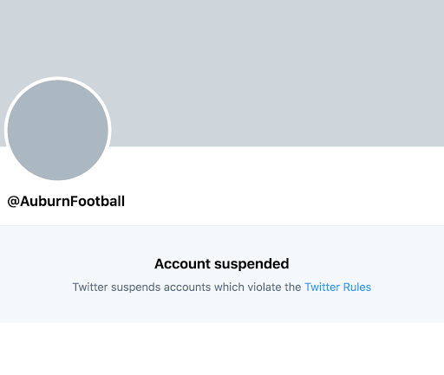
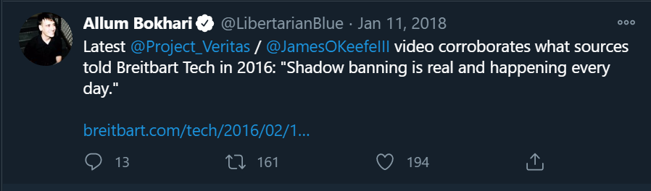
How to check if tweets were deleted
If the account was suspended it will redirect with 302 to https://twitter.com/account/suspended
If the original tweet is still available, and the retweet is unavailable it is because the retweet was deleted
https://rb.gy/x9lkhy
https://inkdroid.org/2017/08/18/delete-forensics/
https://twitter.com/LibertarianBlue/status/951465189161029632
https://ws-dl.blogspot.com/2018/04/2018-04-23-grampa-whats-deleted-tweet.html
Harveen Kaur CS 795: Web Archiving Forensics (Fall 2020)

Slide 16
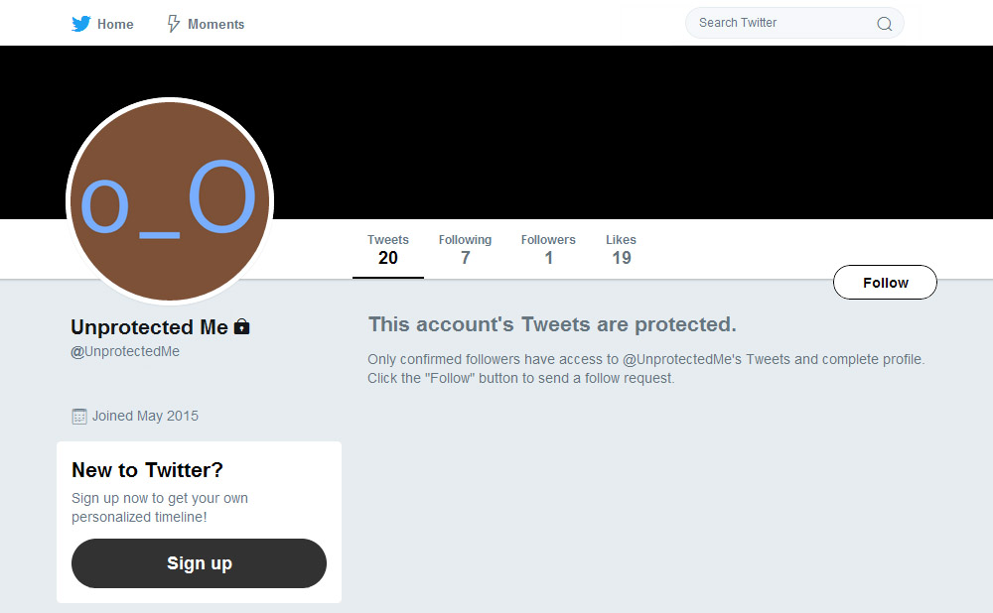
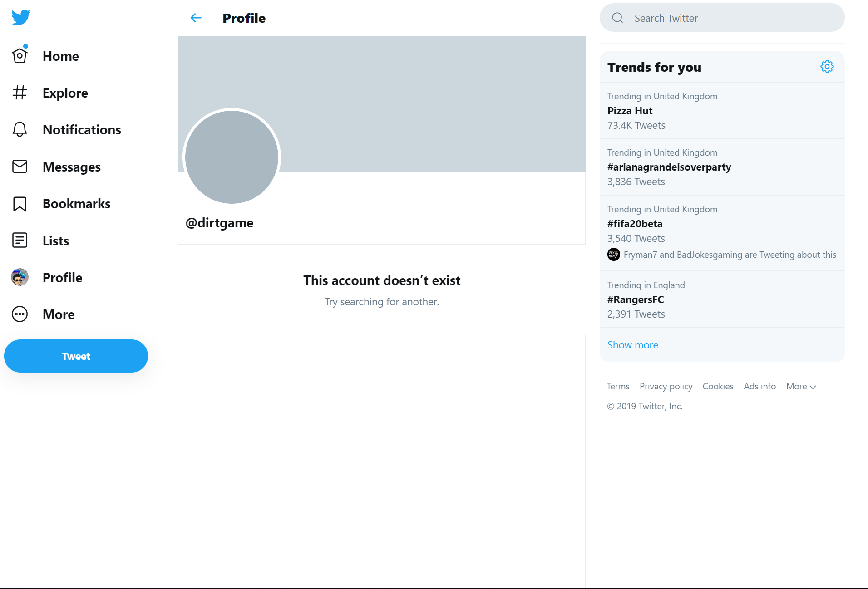
How to check if tweets were deleted
If you visit a user’s profile and it shows you the text “This account’s tweets are protected” then the account is protected
If the Twitter account was deleted by the user you will get a 404 error if you visit the profile
https://inkdroid.org/2017/08/18/delete-forensics/
https://rb.gy/hs7fug
https://rb.gy/znhddk
Harveen Kaur CS 795: Web Archiving Forensics (Fall 2020)

Slide 17
Conclusion
Breitbart News doesn’t delete tweets often
Breitbart News editors account that Breitbart News retweet delete their tweets which results in the deletion of the retweet
There are twitter deletion services that helps you in deleting multiple tweets at once
Web archives are a good source of finding tweets by famous accounts, for less famous accounts it may not be viable
There are several reasons for why a tweet might not be visible including tweet deletion, account deletion, account suspension and tweet protection
Harveen Kaur CS 795: Web Archiving Forensics (Fall 2020)

